Slide 1

Applications of Convolutional Neural Network

Slide 2
Application 1
U-Net: Convolutional Networks for Biomedical
Image Segmentation

Slide 3
In a typical application of CNNs the entire input image is mapped onto a class label and trained by Supervised Learning
But some image processing applications require both classification and localization.
In an extreme case, every pixel needs to be given a class label.
The application developed by Ciresan et al, NIPS (2012) takes the SLIDING WINDOW approach.

Slide 4
Deep neural networks segment neuronal membranes in electron microscopy images. (Ciresan et al 2012)
Input images
Ground truth images

Slide 5
Sliding Window Approach

Slide 6
Disadvantages of the Sliding Window approach
The Sliding Window goes over every pixel in the image.
A lot of overlap of windows.
High redundancy
High Computation
Larger Windows: High classification accuracy; low localization accuracy
Smaller Windows: Low classification accuracy; high localization accuracy

Slide 7
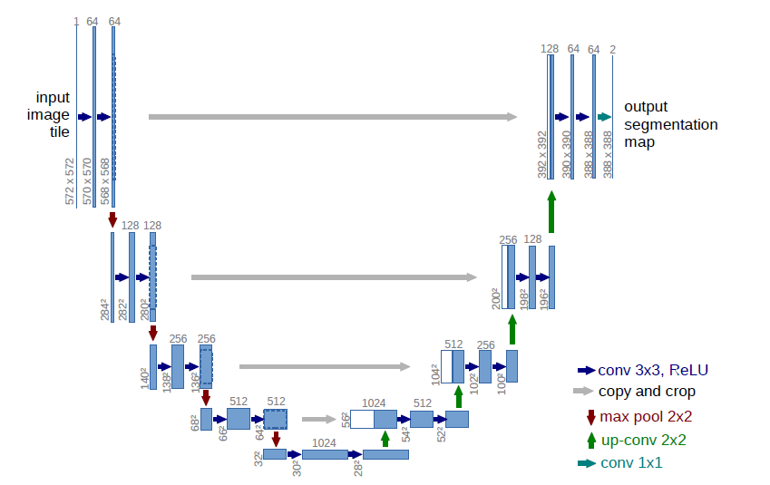
UNET - Architecture

Slide 8
Input image
Ground truth image
Output p_{k}(x): probabilities for K classes

Slide 9
Weight initialization
In large CNNs if the weights are not initialized properly, you will end up with very inhomogeneous activation pattern
Rule for initial weights –
For a neuron with N inputs, let the weights be drawn from a Gaussian with 0 mean and std = sqrt(2/N)
Eg. for a 3x3 convolution and 64 feature channels in the previous layer
N = 9 X 64 = 576.

Slide 10
Data sets – Cell tracking data from EM
PhC-U373 data
DIC-HeLa data
Hela cells
Glioblastoma-astrocytoma
U373 cells

Slide 11
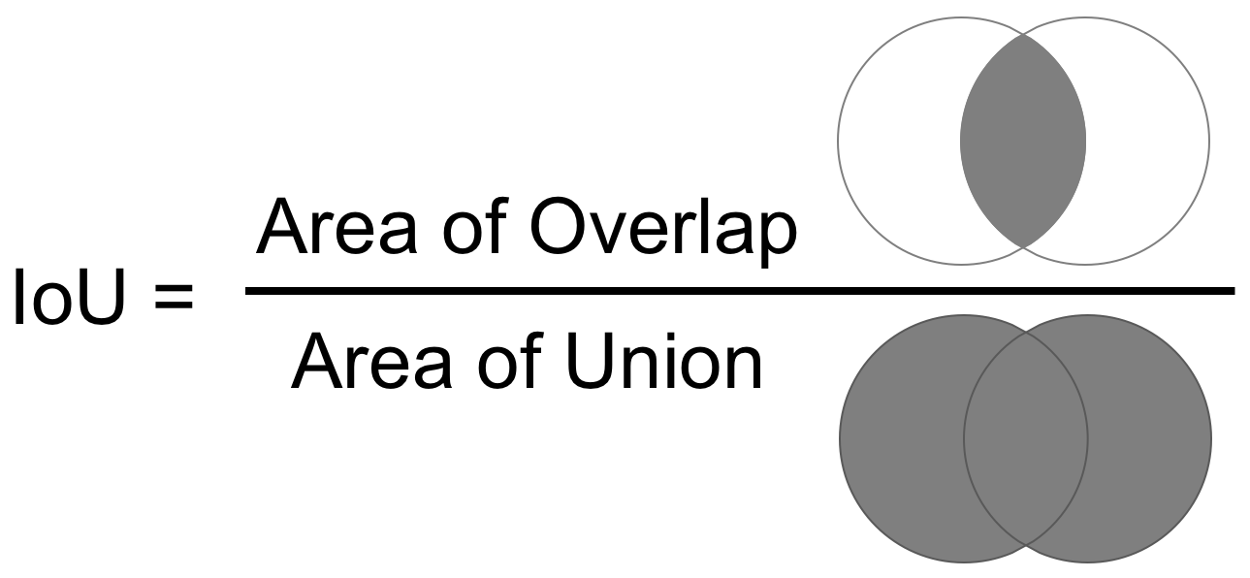
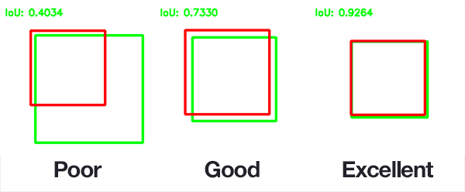
IOU

Slide 12
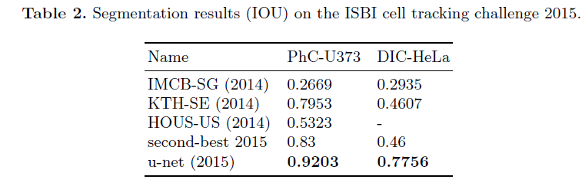
Results
IOU = Intersection Over Union

Slide 13
Application 2
HEP-2 CELL IMAGE CLASSIFICATION
Phan et al, TRANSFER LEARNING OF A CONVOLUTIONAL NEURAL NETWORK FOR HEP-2 CELL IMAGE CLASSIFICATION, 2016.

Slide 14
HEP-2 CELL IMAGE CLASSIFICATION
The recognition of the staining patterns of Human Epithelial-2 (HEp-2) cells in indirect immunofluorescence (IIF) images is essential for the diagnosis of several autoimmune diseases
Aim: to classify HEp-2 cell images by applying transfer learning from a pre-trained deep convolutional neural network (CNN) to extract the generic features and then using a feature selection method to get the most relevant features for classification.
Notes:
TRANSFER LEARNING OF A CONVOLUTIONAL NEURAL NETWORK FOR HEP-2 CELL IMAGE CLASSIFICATION
The recognition of the staining patterns of Human Epithelial-2 (HEp-2) cells in indirect immunofluorescence (IIF) images is essential for the diagnosis of several autoimmune diseases. The main challenge is the extraction and selection of the optimal feature set that not only represents the cells’ characteristics, but also distinguishes between the classes of cell images with similar appearances. In this paper, we propose a system to classify HEp-2 cell images by applying transfer learning from a pre-trained deep convolutional neural network (CNN) to extract the generic features and then using a feature selection method to get the most relevant features for classification.
Indirect Immunofluorescence (IIF) is an important technique for the diagnosis of several autoimmune diseases. IIF images are obtained by staining a biological tissue with antibodies that are tied to a fluorescent chemical compound to detect the distribution of the target antibodies. The observed patterns are the essential information for the diagnosis.

Slide 15
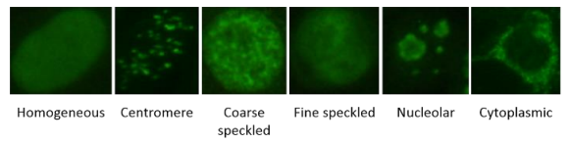
ICPR2012 Dataset
Consists of fluorescence cell images in which each cell is manually segmented and annotated
Mitotic cells and artifact are removed from the set of cell images, leaving only cells that can be categorized into six staining patterns:
centromere (357 cells),
nucleolar (241 cells),
homogenous (330 cells),
fine speckled (208 cells),
coarse speckled (210 cells), and
cytoplasmic (111 cells)
In total, there are 1457 images of cells in the dataset, which are segmented from 28 large images, each belonging to one patient.
Notes:
Dataset The ICPR2012 dataset consists of fluorescence cell images in which each cell is manually segmented and annotated by specialists. Fluorescence intensity and staining pattern are also reported for each single cell. Mitotic cells and artifact are removed from the set of cell images, leaving only cells that can be categorized into six staining patterns: centromere (357 cells), nucleolar (241 cells), homogenous (330 cells), fine speckled (208 cells), coarse speckled (210 cells), and cytoplasmic (111 cells) (Fig. 1). In total, there are 1457 images of cells in the dataset, which are segmented from 28 large images, each belonging to one patient. We utilized the ICPR2012 dataset because it has been publicly available for a long time since 2012, and there are many published methods tested on this baseline dataset that we can compare our method with

Slide 16
Positive Intensity Images
Intermediate Intensity Images

Slide 17
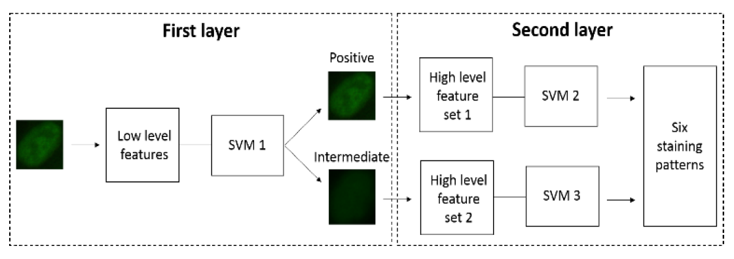
2-stage classification system

Slide 18
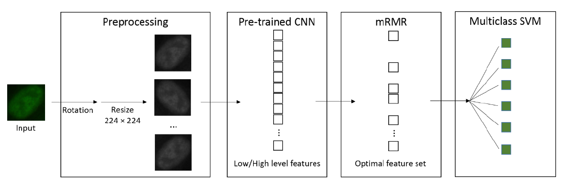

Slide 19
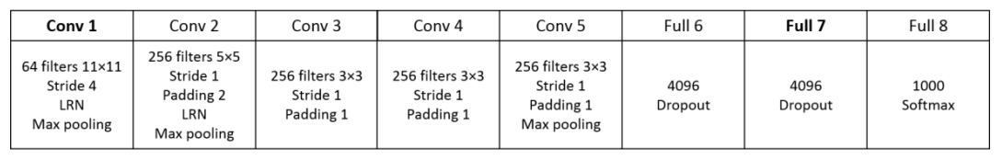
CNN Architecture
5 convolutional layers (conv 1-5)
three fully-connected layers (full 6-8)
Notes:
CNN architecture. The CNN contains 5 convolutional layers (conv 1-5) and three fully-connected layers (full 6-8). LRN: Local Response
Normalization. More details can be found in [10]. The output of the Conv 1 layer is the low level features that is used for the first classification layer. The
output of the Full 7 layer is the 4096 dimensional high level representation of the input image that is used for the second classification layer.

Slide 20
MRMR method
The minimum-Redundancy-Maximum-Relevance (mRMR) algorithm,
sorts the features that are most relevant for the characterization of the classification variable by minimizing their mutual similarity and maximizing their correlation with the classification label,
chosen for its better performance over other conventional top-ranking methods

Slide 21
Testing Protocols
First protocol,
the set of images is partitioned into training and test sets, with 723 and 734 cells respectively, in which the image pattern distribution over the two sets is maintained approximately the same as the original dataset.
Second Protocol
the leave-one-out scheme is applied when segmented cell images of one of the 28 large images are used as the test set and a classifier has to be trained using cell images from the remaining 27 large images.
Notes:
DISCUSSION AND RESULTS
There are two complementing test protocols using the ICPR2012 dataset, presented in [3]. In the first protocol, the set of images is partitioned into training and test sets, with 723 and 734 cells respectively, in which the image pattern distribution over the two sets is maintained approximately the same as the original dataset. Despite the significant drop in the amount of training samples, our proposed classification system (Fig. 2), with an accuracy rate of 77.1%, outperforms all the published algorithms [3] (Table I), including the CNN trained especially with this particular dataset [4], and a specialist in Immunology with 12 years of experience, who worked in exactly the same condition as the automatic methods [1].
In the second protocol, the leave-one-out scheme is applied when segmented cell images of one of the 28 large images are used as the test set and a classifier has to be trained using cell images from the remaining 27 large images [3]. Our method, with the accuracy rate of 91.5%, also obtained the first position among the published methods.

Slide 22
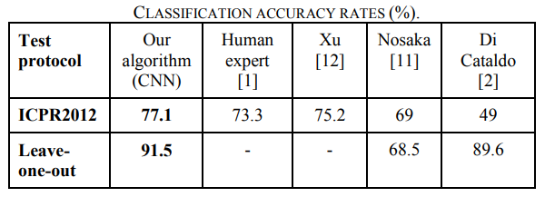
Results
First Protocol
with an accuracy rate of 77.1%, outperforms all the other algorithms
Second Protocol
with the accuracy rate of 91.5%, also obtained the first position among the published methods.

Slide 23
Application 3
Detection and diagnosis of dental caries

Slide 24
Detection and diagnosis of dental caries
Various retention and restoration methods, which have been proposed and improved for the treatment of dental caries
Accurate detection and diagnosis of dental caries reduces the cost of oral health management, and increases the likelihood of natural tooth preservation in the long term.
The Aim of this study was to evaluate the efficacy of deep CNN algorithms for the detection and diagnosis of dental caries in periapical radiographs i.e to classify the input as dental caries and non-dental caries.
Notes:
Various retention and restoration methods, which have been proposed and improved for the treatment of dental caries, have been successfully developed over the past few decades. However, there has not yet been a significant improvement in the diagnostic methodology for detecting dental caries due to various anatomical morphologies of teeth and the shapes of restorations.
For

Slide 25
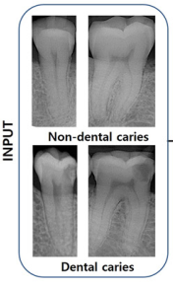
Detection and diagnosis of dental caries
The dataset consisted of a total of 3000 periapical radiographic images.
781 (23.9%) premolars + 772 (25.7%) molars were dental caries
719 (26.1%) premolars + 728 (24.3%) molars were non-dental caries
Training + Validation Dataset
1200 dental caries
1200 non-dental caries
Test Dataset
300 dental caries
300 non-dental caries
The training dataset was randomly augmented 10 times using
rotation, width and height shifting, zooming, shearing, and
horizontal flip
Three Models were trained,
For molar images
For premolar images
For molar+premolar images.
Notes:
The training and validation dataset consisted of 1200 dental caries and 1200 non-dental caries, and the test dataset consisted of 300 dental caries and 300 on-dental caries in the same ratio.
The training dataset was randomly augmented 10 times using rotation (range of 10°), width and height shifting (range, 0.1), zooming (range, 0.8–1.2), shearing range, 0.5), and horizontal flip.

Slide 26
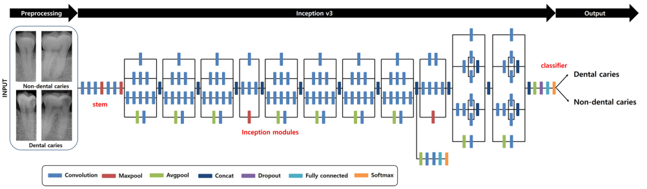
Detection and diagnosis of dental caries
A pre-trained GoogLeNet Inception v3 CNN network was used for preprocessing, and the datasets were trained using transfer learning.
The inception v3 architecture consists of 22 deep layers.
A total of 9 inception modules were used, including two fully connected layers, and softmax functions.

Slide 27
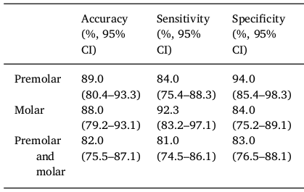
Results
Specificity=
TN/(TN+FP)
Because the treatment process of dental caries is irreversible, specificity is considered to be a more important factor in diagnosing dental caries than accuracy and/or sensitivity.
The present study demonstrated that the accuracy difference between premolars and the molar was only 1%, but the specificity of diagnosis of premolars was higher by 10% than that of molars.
Notes:
Because the treatment process of dental caries is irreversible, specificity is considered to be a more important factor in diagnosing dental caries than accuracy and/or
sensitivity. The present study demonstrated that the accuracy between premolars and the molar was only 1%, but the specificity of diagnosis of premolars was higher by 10% than that of molars.

Slide 28
Application 4
Thorax Disease Diagnosis

Slide 29
Thorax Disease Diagnosis
In radiology, one of the widely used examinations is chest radiographs.
They are important for the diagnosis of various diseases associated with high mortality.
To improve the efficiency of radiologists, a new algorithm is proposed to preprocess the thorax (chest) radiographic images and filter out the images taken from healthy persons. Only those images suspected abnormal will be further checked by doctors.
PROPOSED FRAMEWORK:
First, image alignment is performed and then the dataset is enlarged using a technique called Scale Space Theory (SST). After that the dataset is augmented by cropping, flipping and rotating.

Slide 30
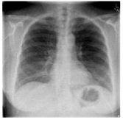
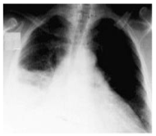
Thorax Disease Diagnosis
The dataset consists of 4000 CT images for thorax from 2000 patients.
Half of the images are from healthy persons and half from unhealthy ones.
Original Four models were trained
images without any pre-processing or augmentation. (Orig)
Original Images with alignment only (Align)
Original Images with alignment and enlargement using SST. (Align+SST)
Original Images with alignment, enlargement and data augmentation (Align+SST+DataAug)
Unhealthy person
Healthy person

Slide 31
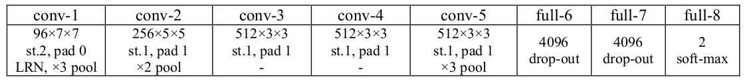
Thorax Disease Diagnosis
NETWORK ARCHITECTURE:
The architecture contains five convolutional layers (conv 1–5) and three fully connected layers (full 6–8).
LRN = Local response normalisation.
Notes:
it contains
five convolutional layers (conv 1–5) and three fully-
connected layers (full 6–8).
LRN = Local response normalisation.
The activation function for all weight
layers (except for full8) is the Rectification Linear Unit
(ReLU)

Slide 32
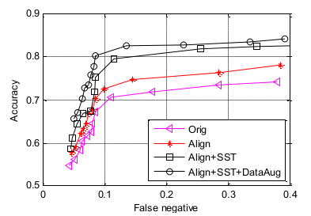
Thorax Disease Diagnosis
RESULT:
Accuracy = percentage of both healthy and unhealthy samples correctly classified.
False negative = percentage of unhealthy samples classified to be healthy ones.
Aligning the images in the dataset improves the performance of the final CNN model by 2-3%.
The SST improves another 3-4%.
In addition, data augmentation achieves 2-3% more accuracy gain
Ref: Thorax disease diagnosis using deep convolutional neural network, 2016
Notes:
the accuracy means that the percentage of both
healthy and unhealthy samples are correctly classified. The
false negative means that the percentage of unhealthy
samples classified to be healthy ones. From Fig. 5 (a), we can
find that aligning the images in the dataset improves the
performance of the final CNN model by 2-3%. The SST
improves another 3-4%. In addition, data augmentation
achieves 2-3% more accuracy gain

